Slide 1
Adolescent and Young Adult
Oncology
Scientific Meeting 2013
Epidemiology Working Group
Notes:
HAPPY TO BE KICKING THE MEETING OFF.
HOPE WE CAN PROVIDE A SOLID FOUNDATION FOR DISCUSSION.

Slide 2
Members
Ann Geiger, NCI, Chair
Archie Bleyer, Oregon Health and Science University, Co-Chair
Ronald Barr, McMaster University
Lynne Harlan, NCI
Theresa Keegan, Cancer Prevention Institute of California
Denis Lewis, NCI
Brad Pollock, University of Texas Health Science Center at San Antonio
Lynn Ries, NCI (sends her regrets)
Deborah Vollmer Dahlke, Texas A&M University Health Science Center
Notes:
GREAT GROUP, LIVELY CALLS
MIX OF:
LEADERS IN THE FIELD
NCI STAFF WITH LONG-TERM INVOLVEMENT
NEWER ENTRANTS
WORK A COLLECTIVE EFFORT, ALTHOUGH EFFICIENCY DEMANDS ONLY ABOUT HALF OF US CAN PRESENT TODAY

Slide 3
Outline
General Introduction & Breast: Ann
Melanoma & colorectal: Theresa
Leukemia & sarcoma: Denise
Beyond SEER: Deborah
Additional Observations & Summary: Archie
Questions for Discussion: Last Slide

Slide 4
Methods
AYA = 15 to 39 years old, inclusive
2000 to 2010 and subintervals
SEER 18 (28% of US Population)
  Limited publication of population-based, non-site specific cancer epidemiology focused on AYA
Notes:
STUCK WITH SEER DUE TO LIMITED PUBLICATION OF POPULATION-BASED EPIDEMIOLOGY FOCUSING ON THIS AGE GROUP AND CROSSING CANCER TYPES
FOCUSING THIS PRESENTATION ON MATERIAL NOT COVERED IN PRE-MEETING REPORT:
TRENDS
FIVE FOCUS CANCERS

Slide 5
Not Done
Prevalence
Stage at diagnosis for children, AYA, and older adults with the same cancers
Only risk factor information is age, sex, and race/ethnicity
Interpretation
Notes:
GROUP COULD NOT RESOLVE WHO TO COUNT AS PREVALENT:
DIAGNOSED AS & CURRENTLY AYA
DIAGNOSED DURING CHILDHOOD & CURRENTLY AYA
OLDER ADULTS DIAGNOSED AS CHILDREN OR AYA
OLDER ADULTS DIAGNOSED AS AYA
RISK FACTOR INFORMATION REMAINS VERY LIMITED
PRESENTING NUMBERS, EXPECT INTERPRETATIONS TO EMERGE THROUGHOUT THE DAY

Slide 6
Caution
Incidence and mortality rates per 100,000
  horizontal x axis shifts
Trends
Lots of information – copies of graphs available
Notes:
AXIS SHIFTS IN EAGLE PLOTS
TRENDS ARE TRICKY – WE ARE PRESENTING EVERYTHING BUT WANT TO URGE EVERYONE NOT TO PUT TOO MUCH STAKE IN THE SPECIFIC NUMBERS OR STATISTICAL SIGNIFICANCE – INSTEAD FOCUS ON PATTERNS
WILL RUN THROUGH LOTS OF INFORMATION – COPIES AVAILABLE FOR DISCUSSION PERIO

Slide 7
Age at Diagnosis (Years)
Average Annual % Change (AAPC) in Incidence of Cancers in AYAs
by 15 -Year Age-at-Diagnosis Intervals
2000-2010
SEER18 (28% of U.S.)
AAPC:
* In males ** in females
*** excluding non-malignant
^ Kaposi sarcoma
Age at Diagnosis (Years)
Notes:
Thyroid and kidney carcinoma are dramatically increasing in AYAs and older adults (and for thyroid cancer, in children). Colorectal and testis carcinoma is increasing in young AYAs but not as rapidly as thyroid and kidney cancer. ALL was increasing in and only in AYAs, but the trend ceased in 2008 (data not shown). Breast cancer may be increasing in young AYAs during the past decade. Lung cancer declined in older AYAs as did melanoma and carcinoma of the cervix in young AYAs.
Potential explanations. The good news for melanoma and lung cancer may have resulted from successful skin cancer prevention campaigns and the inclusion of the whole state of California in SEER18 and its statewide anti-tobacco initiatives. The dramatic increase in thyroid and kidney cancer is likely due increased ease of detection due to advances in diagnostic imaging (ultrasound, etc.). The recent decrease in ALL may a nosologic artifact in that recent changes in classification of leukemia and lymphoma may have moved ALL in to another category. The increase in colorectal carcinoma incidence may be due to an increase in HPV-associated rectal cancer and increased detection (colonoscopy).
*This raises the question of overdiagnosis and unnecessary therapy, primarily radio-iodine for thyroid cancer and surgery for renal cancer.

Slide 8
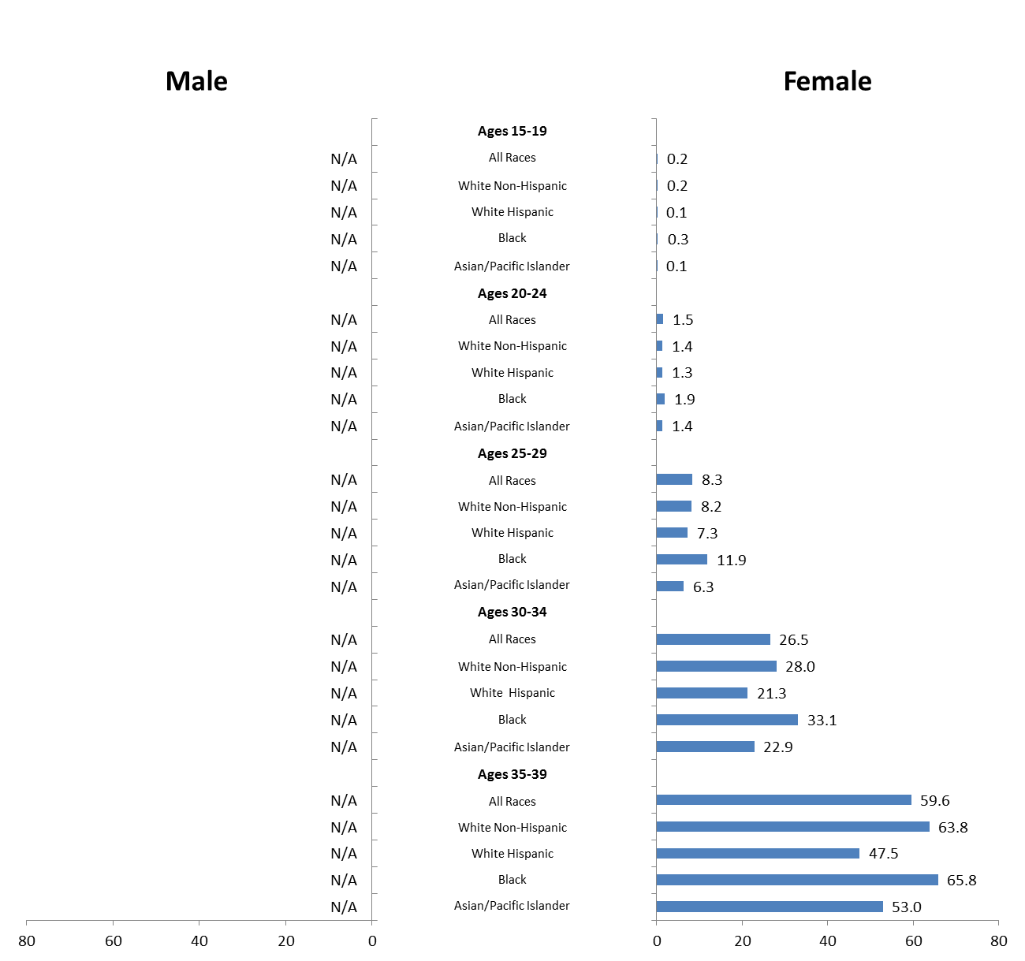
BREAST CANCER
INCIDENCE
per 100,000
2001-2010
Ages 15-19
All Races
White Non-Hispanic
White Hispanic
Black
Asian/Pacific Islander
Ages 20-24
All Races
White Non-Hispanic
White Hispanic
Black
Asian/Pacific Islander
Ages 25-29
All Races
White Non-Hispanic
White Hispanic
Black
Asian/Pacific Islander
Ages 30-34
All Races
White Non-Hispanic
White Hispanic
Black
Asian/Pacific Islander
Ages 35-39
All Races
White Non-Hispanic
White Hispanic
Black
Asian/Pacific Islander
Notes:
HAVE SEEN THIS SORT OF GRAPH IN REPORT AND WILL SEE THROUGHOUT THIS PRESENTATION.
MALES TO LEFT AND FEMALES TO RIGHT
YOUNGEST AT TOP
WHITE, HISPANIC, BLACK, AND ASIAN – DEBATE ABOUT HOW TO HANDLE RACE AND ETHNICITY, COMBINED INTO ONE VARIABLE WITH MUSUALLY EXCLUSIVE CATEGORIES
BREAST CANCER INCIDENCE RATE RANGES FROM ESSENTIALLY 0 TO 65.8 PER 100,000
INCIDENCE RATE INCREASES WITH AGE.
LOWER INCIDENCE IN HISPANICS AND ASIANS, BLACKS EQUIVALENT TO OR SLIGHTLY HIGHER THAN WHITES

Slide 9
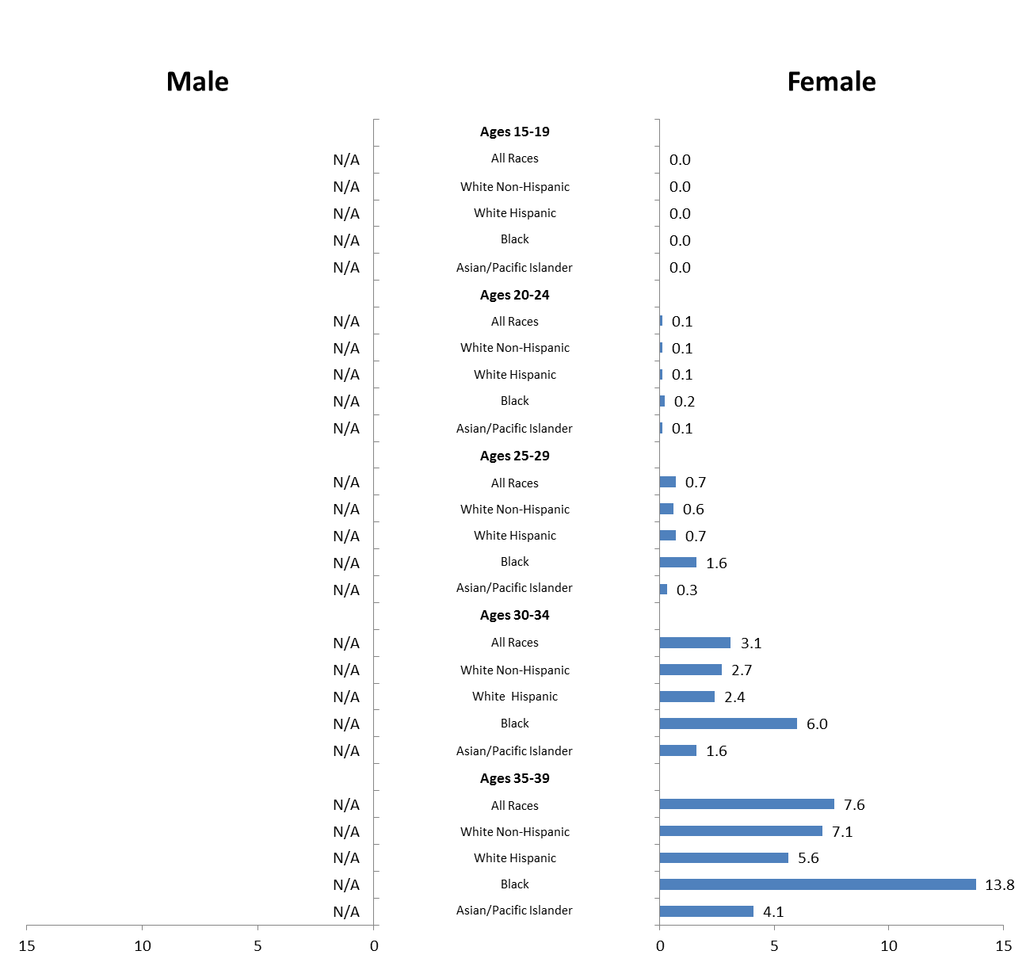
BREAST CANCER
MORTALITY
per 100,000
2001-2010
Ages 15-19
All Races
White Non-Hispanic
White Hispanic
Black
Asian/Pacific Islander
Ages 20-24
All Races
White Non-Hispanic
White Hispanic
Black
Asian/Pacific Islander
Ages 25-29
All Races
White Non-Hispanic
White Hispanic
Black
Asian/Pacific Islander
Ages 30-34
All Races
White Non-Hispanic
White Hispanic
Black
Asian/Pacific Islander
Ages 35-39
All Races
White Non-Hispanic
White Hispanic
Black
Asian/Pacific Islander
Notes:
MORTALITY RATE RANGES FROM 0 TO 13.8
INCREASES WITH AGE
NOTICEABLY HIGHER MORTALITY RATE IN BLACK WOMEN

Slide 10
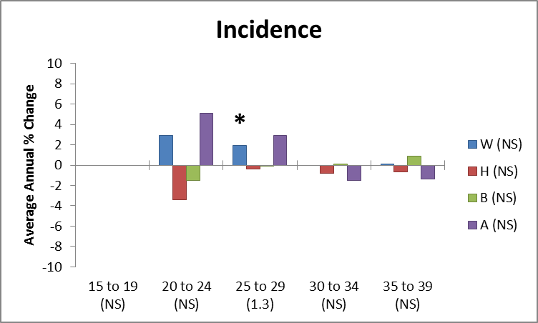
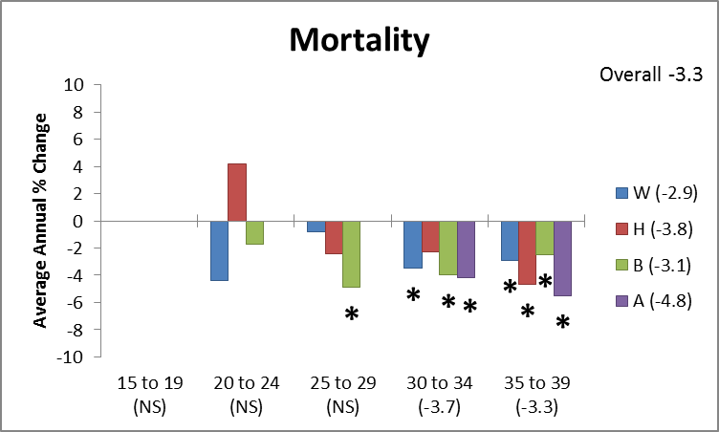
BREAST CANCER
TRENDS
Overall
Incidence NS
Mortality -3.3
Notes:
TRIED TO CAPTURE COMPLEX INFORMATION WITH THIS GRAPH
AAPC ON VERTICAL AXIS = Average Annual Percent Change (AAPC) is a summary measure of the trend over a pre-specified fixed interval. It allows us to use a single number to describe the average APCs over a period of multiple years. It is valid even if the joinpoint model indicates that there were changes in trends during those years. It is computed as a weighted average of the APC's from the joinpoint model, with the weights equal to the length of the APC interval.
AGE GROUP ON HORIZONTAL AXIS
RACE/ETHNICITY DESIGNATED BY COLOR
NS – NOT STATISTICALY SIGNIFICANT. SIGNIFICANT NOTED BY NUMBER OR STAR. REMEMBER SIGNIFICANCE A FUNCTION OF BOTH EFFECT AND SAMPLE SIZES
INCIDENCE – OVERALL NOT STATISTICALLY SIGNIFICANT. WHITES AGED 25 TO 29 YEARS SIGNIFICANT INCREASE IN INCIDENCE BUT NO REAL PATTERN.
MORTALITY – NOTABLE DECREASES IN RATE, INCREASED SURVIVAL, ACROSS ALL RACE/ETHNICITIES IN WOMEN 30 YEARS OF AGE AND OLDER

Slide 11
BREAST: Summary
Incidence rates
  Increase with age
  Similar blacks and whites
  No trend
Mortality rates
  Increase with age
  Higher in blacks
  Decreasing

Slide 12
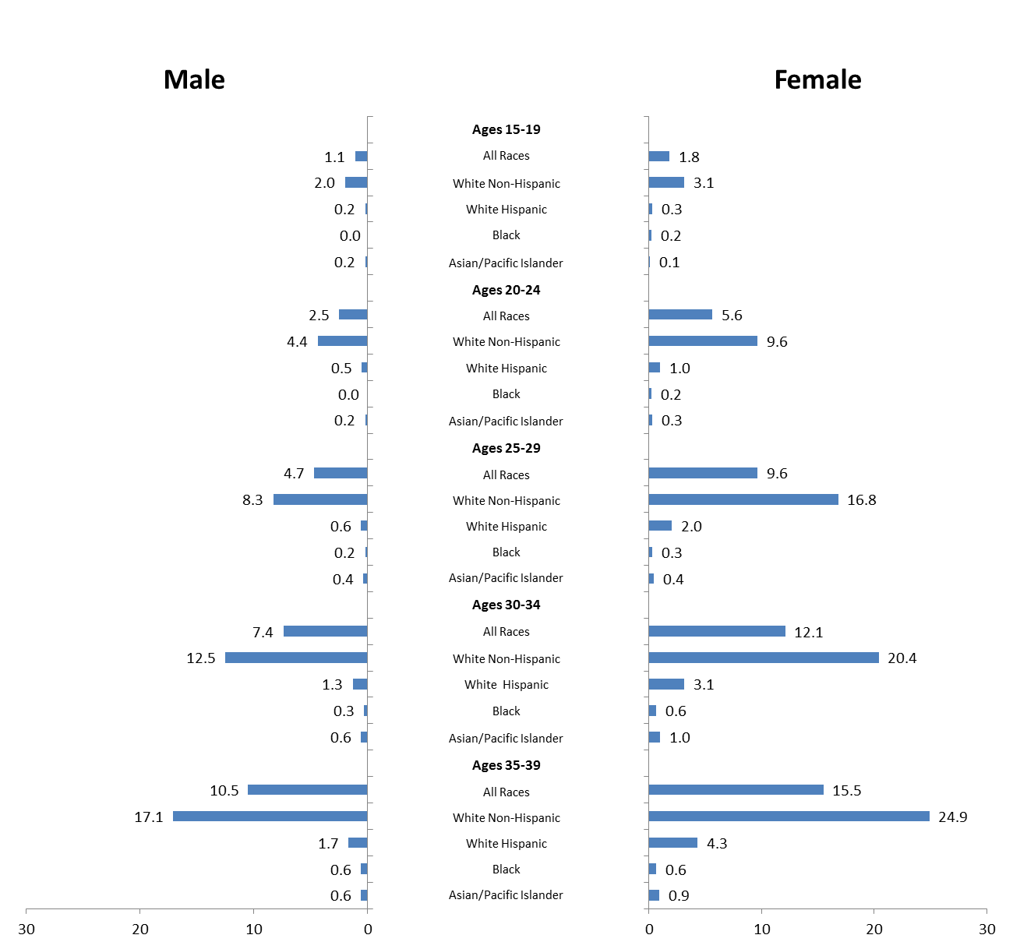
MELANOMA
INCIDENCE
per 100,000
2001-2010
Ages 15-19
All Races
White Non-Hispanic
White Hispanic
Black
Asian/Pacific Islander
Ages 20-24
All Races
White Non-Hispanic
White Hispanic
Black
Asian/Pacific Islander
Ages 25-29
All Races
White Non-Hispanic
White Hispanic
Black
Asian/Pacific Islander
Ages 30-34
All Races
White Non-Hispanic
White Hispanic
Black
Asian/Pacific Islander
Ages 35-39
All Races
White Non-Hispanic
White Hispanic
Black
Asian/Pacific Islander
Notes:
4TH MOST COMMON CANCER IN AYAS, FOLLOWING BREAST, THYROID AND LYMPHOMA
MELANOMA PREDOMINANTLY OCCURS IN NON-HISPANIC WHITES
INCIDENCE RATES, PER 100,000, RANGE FROM 0 IN BLACK MEN <25 YEARS OF AGE TO 24.9 IN NON-HISPANIC WHITE WOMEN 35-39 YEARS OF AGE
FROM THE EARLY 20’S UNTIL LATE 30’S, INCIDENCE RATES ROUGHLY TRIPLE
HIGHER INCIDENCE RATE IN WOMEN VERSUS MEN

Slide 13
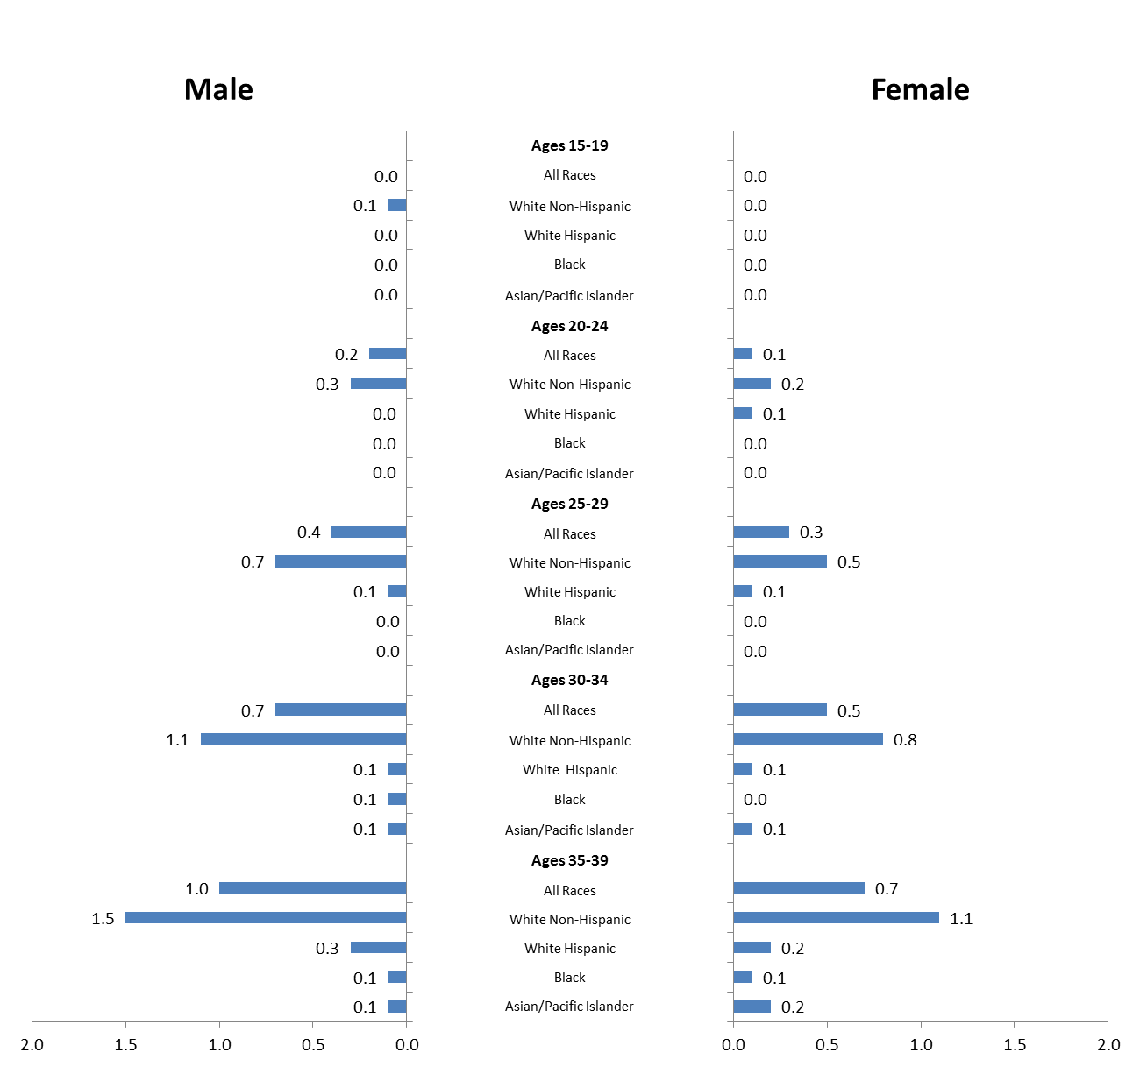
MELANOMA
MORTALITY
per 100,000
2001-2010
Ages 15-19
All Races
White Non-Hispanic
White Hispanic
Black
Asian/Pacific Islander
Ages 20-24
All Races
White Non-Hispanic
White Hispanic
Black
Asian/Pacific Islander
Ages 25-29
All Races
White Non-Hispanic
White Hispanic
Black
Asian/Pacific Islander
Ages 30-34
All Races
White Non-Hispanic
White Hispanic
Black
Asian/Pacific Islander
Ages 35-39
All Races
White Non-Hispanic
White Hispanic
Black
Asian/Pacific Islander
Notes:
MORTALITY RATES FROM MELANOMA RANGE FROM 0 IN YOUNG MEN AND WOMEN UNDER 25 YEARS OF AGE TO 1.5 PER 100,000 IN NON-HISPANIC WHITE MEN 35-39 YEARS OF AGE
PARALLELLING INCIDENCE, MORTALITY RATES INCREASE WITH AGE AND ARE HIGHEST IN NON-HISPANIC WHITES.
UNLIKE INCIDENCE, HOWEVER, MALES HAVE HIGHER MORTILTY RATES THAN FEMALES.
In a recent publication using SEER data in JAMA Dermatology, we found Adolescent and young adult white males were 55% more likely to die of melanoma than AYA females after adjustment for tumor thickness, histologic subtype, anatomic location, presence and extent of metastasis, and anatomical location. In these data from 1989 to 2009, males accounted for 39.8% of overall cases of melanoma but 63.6% of melanoma-specific deaths.

Slide 14
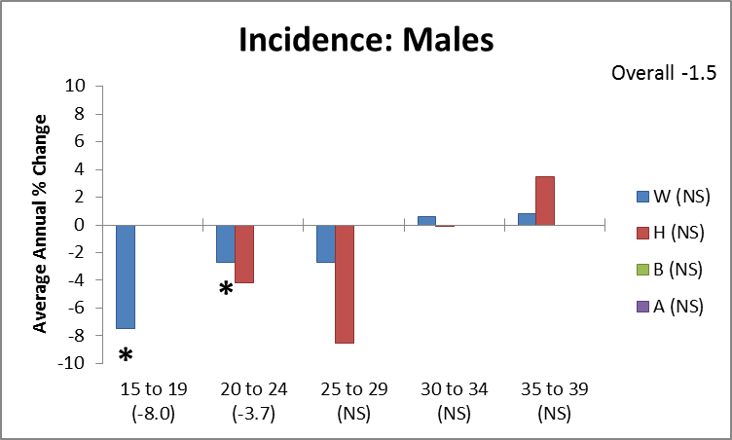
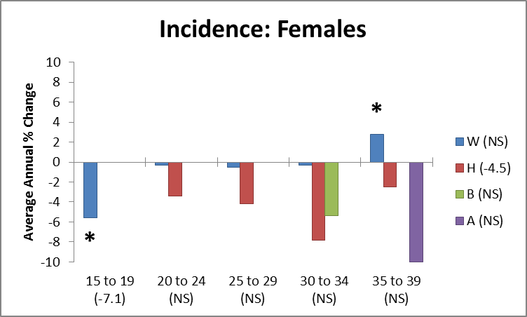
MELANOMA
TRENDS
Overall
Incidence
Males -1.5
Females NS
Mortality too low to assess
Notes:
FROM 2001 TO 2010, THERE WERE NO STATISTICALLY SIGNIFICANT CHANGES IN INCIDENCE RATES OVERALL; HOWEVER, THERE APPEARED TO BE SOME DECLINES, PARTICULARLY IN YOUNGER AGE GROUPS AND WELL AS IN HISPANIC WOMEN
NOTABLY, INCIDENCE RATES INCREASED 2.8% PER YEAR AMONG NON-HISPANIC WHITE WOMEN AGED 35 TO 39
WE FOUND NO DETECTABLE TRENDS IN MORTALITY RATES.
OBSERVED 5-YEAR SURVIVAL ACROSS RACE/ETHNICITY AND GENDER EXCEEDS 90% (2000-2005). A SEER17 ANALYSIS FOUND SIGNIFICANTLY BETTER 5-YEAR RELATIVE SURVIVAL AFTER DIAGNOSIS OF MELANOMA FOR AYAS THAN OLDER ADULTS.

Slide 15
Melanoma: Summary
Incidence rates
  Increase with age
  Higher in women and in whites
  Declining
Mortality rates
  Increase with age
  Higher in whites
  No trend assessment

Slide 16
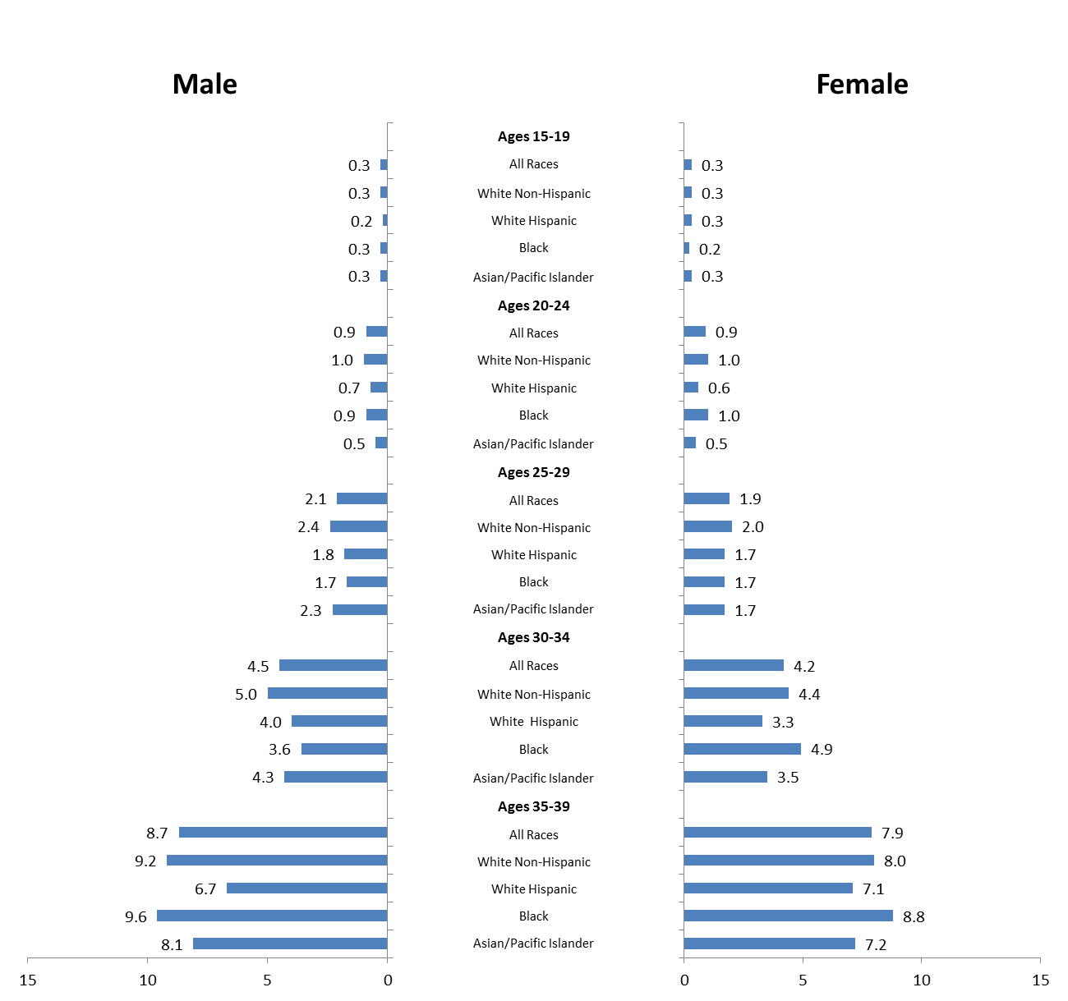
COLORECTAL
CANCER
INCIDENCE
per 100,000
2001-2010
Ages 15-19
All Races
White Non-Hispanic
White Hispanic
Black
Asian/Pacific Islander
Ages 20-24
All Races
White Non-Hispanic
White Hispanic
Black
Asian/Pacific Islander
Ages 25-29
All Races
White Non-Hispanic
White Hispanic
Black
Asian/Pacific Islander
Ages 30-34
All Races
White Non-Hispanic
White Hispanic
Black
Asian/Pacific Islander
Ages 35-39
All Races
White Non-Hispanic
White Hispanic
Black
Asian/Pacific Islander
Notes:
COLORECTAL INCIDENCE RATES FRANGE FROM 0.2 TO 9.6 CASES PER 100,000
CONTINUING THEME – INCREASING INCIDENCE WITH AGE
MALE INCIDENCE RATE TENDS TO BE HIGHER
REASONABLE CONSISTENCY AMONG RACIAL/ETHNIC GROUPS, ALTHOUGH EMERGING LOWER INCIDENCE RATES IN HISPANICS AND ASIANS IN OLDER AGE GROUPS

Slide 17
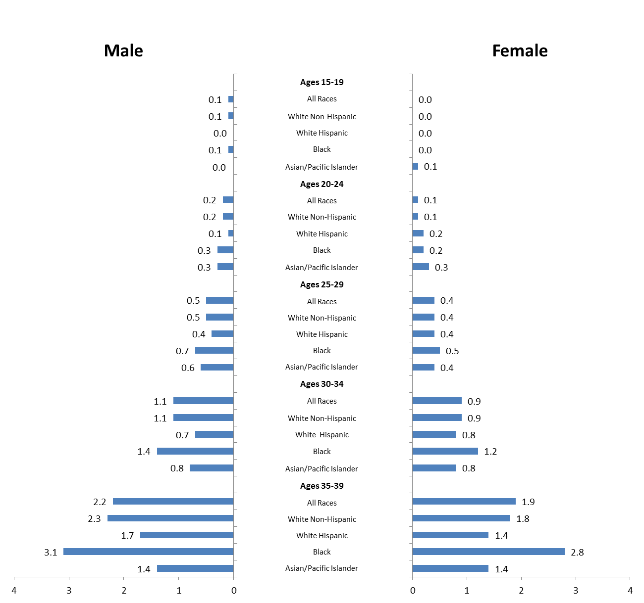
COLORECTAL
CANCER
MORTALTY
per 100,000
2001-2010
Ages 15-19
All Races
White Non-Hispanic
White Hispanic
Black
Asian/Pacific Islander
Ages 20-24
All Races
White Non-Hispanic
White Hispanic
Black
Asian/Pacific Islander
Ages 25-29
All Races
White Non-Hispanic
White Hispanic
Black
Asian/Pacific Islander
Ages 30-34
All Races
White Non-Hispanic
White Hispanic
Black
Asian/Pacific Islander
Ages 35-39
All Races
White Non-Hispanic
White Hispanic
Black
Asian/Pacific Islander
Notes:
COLORECTAL MORTALITY RATES RANGE FROM 0 TO 3.1 CASES PER 100,000
INCREASE WITH AGE…
POSSIBLE HIGHER MORTALITY RATES IN MALES RELATIVE TO FEMALES
MORTALITY RATES NOTABLY HIGHER IN BLACKS

Slide 18
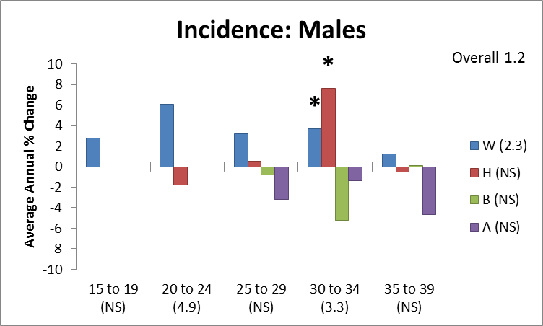
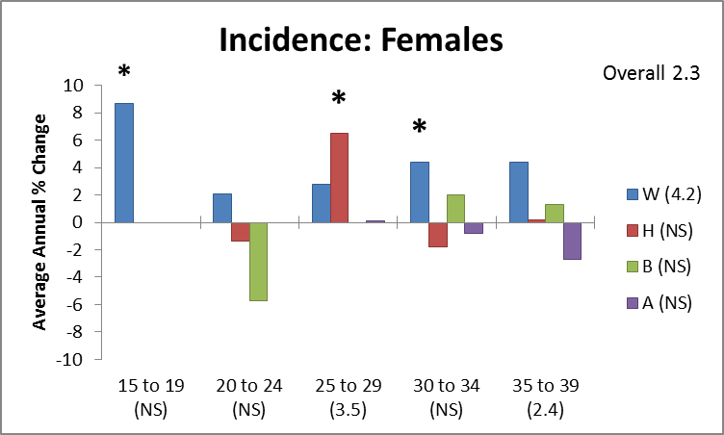
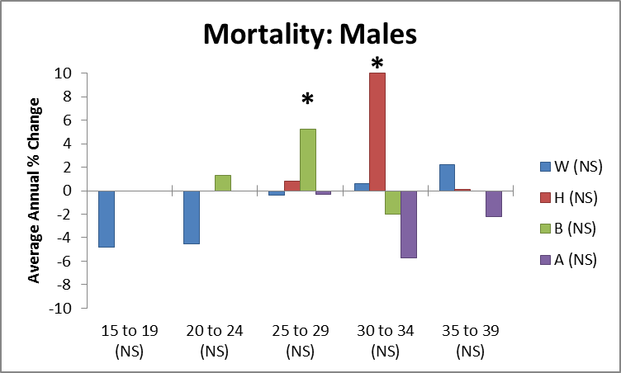
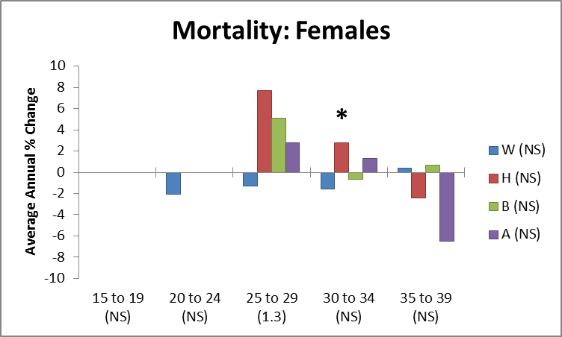
COLORECTAL
CANCER
TRENDS
Overall
Incidence
Males +1.2
Females +2.3
Mortality NS
Notes:
CONCERNING INCREASE IN INCIDENCE RATES, ON ORDER OF 1 TO 2%
ONE OF MOST STRIKING TRENDS WE OBSERVED
BOTH MEN AND WOMEN
TEND TOWARD OLDER AND WHITE, BUT MAY BE DUE TO SAMPLE SIZE

Slide 19
Colorectal: Summary
Incidence rates
  Increase with age
  Modestly higher in males
  Increasing
Mortality rates
  Increase with age
  Much higher in blacks
  Trend?

Slide 20
LEUKEMIA
INCIDENCE
per 100,000
2001-2010
Ages 15-19
All Races
White Non-Hispanic
White Hispanic
Black
Asian/Pacific Islander
Ages 20-24
All Races
White Non-Hispanic
White Hispanic
Black
Asian/Pacific Islander
Ages 25-29
All Races
White Non-Hispanic
White Hispanic
Black
Asian/Pacific Islander
Ages 30-34
All Races
White Non-Hispanic
White Hispanic
Black
Asian/Pacific Islander
Ages 35-39
All Races
White Non-Hispanic
White Hispanic
Black
Asian/Pacific Islander
Notes:
LEUKEMIA INCIDENCE RATE RANGES FROM 1.7 TO 5.6 CASES PER 100,000
SOME BUT NOT A MARKED INCREASE WITH AGE
FEMALE INCIDENCE RATE LOWER THAN MALE
INCIDENCE ACROSS RACE/ETHNICITY FAIRLY CONSISTENT – SOME OUTLIERS IN HISPANIC GROUP

Slide 21
Age Adjusted Incidence Rates 2001-2010, Leukemia
Age Adjusted Incidence Rates 2001-2010, Leukemia
Age Adjusted Incidence Rates 2001-2010, Leukemia
Ages 15-19
All Races
White Non-Hispanic
White Hispanic
Black
Asian/Pacific Islander
Ages 20-24
All Races
White Non-Hispanic
White Hispanic
Black
Asian/Pacific Islander
Ages 25-29
All Races
White Non-Hispanic
White Hispanic
Black
Asian/Pacific Islander
Ages 30-34
All Races
White Non-Hispanic
White Hispanic
Black
Asian/Pacific Islander
Ages 35-39
All Races
White Non-Hispanic
White Hispanic
Black
Asian/Pacific Islander
Age Adjusted Incidence Rates 2001-2010, Leukemia
Ages 15-19
All Races
White Non-Hispanic
White Hispanic
Black
Asian/Pacific Islander
Ages 20-24
All Races
White Non-Hispanic
White Hispanic
Black
Asian/Pacific Islander
Ages 25-29
All Races
White Non-Hispanic
White Hispanic
Black
Asian/Pacific Islander
Ages 30-34
All Races
White Non-Hispanic
White Hispanic
Black
Asian/Pacific Islander
Ages 35-39
All Races
White Non-Hispanic
White Hispanic
Black
Asian/Pacific Islander
Ages 15-19
All Races
White Non-Hispanic
White Hispanic
Black
Asian/Pacific Islander
Ages 20-24
All Races
White Non-Hispanic
White Hispanic
Black
Asian/Pacific Islander
Ages 25-29
All Races
White Non-Hispanic
White Hispanic
Black
Asian/Pacific Islander
Ages 30-34
All Races
White Non-Hispanic
White Hispanic
Black
Asian/Pacific Islander
Ages 35-39
All Races
White Non-Hispanic
White Hispanic
Black
Asian/Pacific Islander
Ages 15-19
All Races
White Non-Hispanic
White Hispanic
Black
Asian/Pacific Islander
Ages 20-24
All Races
White Non-Hispanic
White Hispanic
Black
Asian/Pacific Islander
Ages 25-29
All Races
White Non-Hispanic
White Hispanic
Black
Asian/Pacific Islander
Ages 30-34
All Races
White Non-Hispanic
White Hispanic
Black
Asian/Pacific Islander
Ages 35-39
All Races
White Non-Hispanic
White Hispanic
Black
Asian/Pacific Islander
LEUKEMIA
MORTALITY
per 100,000
2001-2010
Ages 15-19
All Races
White Non-Hispanic
White Hispanic
Black
Asian/Pacific Islander
Ages 20-24
All Races
White Non-Hispanic
White Hispanic
Black
Asian/Pacific Islander
Ages 25-29
All Races
White Non-Hispanic
White Hispanic
Black
Asian/Pacific Islander
Ages 30-34
All Races
White Non-Hispanic
White Hispanic
Black
Asian/Pacific Islander
Ages 35-39
All Races
White Non-Hispanic
White Hispanic
Black
Asian/Pacific Islander
Ages 15-19
All Races
White Non-Hispanic
White Hispanic
Black
Asian/Pacific Islander
Ages 20-24
All Races
White Non-Hispanic
White Hispanic
Black
Asian/Pacific Islander
Ages 25-29
All Races
White Non-Hispanic
White Hispanic
Black
Asian/Pacific Islander
Ages 30-34
All Races
White Non-Hispanic
White Hispanic
Black
Asian/Pacific Islander
Ages 35-39
All Races
White Non-Hispanic
White Hispanic
Black
Asian/Pacific Islander
Age Adjusted Death Rates 2001-2010, Leukemia
Age Adjusted Death Rates 2001-2010, Leukemia
Age Adjusted Death Rates 2001-2010, Leukemia
Ages 15-19
All Races
White Non-Hispanic
White Hispanic
Black
Asian/Pacific Islander
Ages 20-24
All Races
White Non-Hispanic
White Hispanic
Black
Asian/Pacific Islander
Ages 25-29
All Races
White Non-Hispanic
White Hispanic
Black
Asian/Pacific Islander
Ages 30-34
All Races
White Non-Hispanic
White Hispanic
Black
Asian/Pacific Islander
Ages 35-39
All Races
White Non-Hispanic
White Hispanic
Black
Asian/Pacific Islander
Age Adjusted Death Rates 2001-2010, Leukemia
Ages 15-19
All Races
White Non-Hispanic
White Hispanic
Black
Asian/Pacific Islander
Ages 20-24
All Races
White Non-Hispanic
White Hispanic
Black
Asian/Pacific Islander
Ages 25-29
All Races
White Non-Hispanic
White Hispanic
Black
Asian/Pacific Islander
Ages 30-34
All Races
White Non-Hispanic
White Hispanic
Black
Asian/Pacific Islander
Ages 35-39
All Races
White Non-Hispanic
White Hispanic
Black
Asian/Pacific Islander
Ages 15-19
All Races
White Non-Hispanic
White Hispanic
Black
Asian/Pacific Islander
Ages 20-24
All Races
White Non-Hispanic
White Hispanic
Black
Asian/Pacific Islander
Ages 25-29
All Races
White Non-Hispanic
White Hispanic
Black
Asian/Pacific Islander
Ages 30-34
All Races
White Non-Hispanic
White Hispanic
Black
Asian/Pacific Islander
Ages 35-39
All Races
White Non-Hispanic
White Hispanic
Black
Asian/Pacific Islander
Ages 15-19
All Races
White Non-Hispanic
White Hispanic
Black
Asian/Pacific Islander
Ages 20-24
All Races
White Non-Hispanic
White Hispanic
Black
Asian/Pacific Islander
Ages 25-29
All Races
White Non-Hispanic
White Hispanic
Black
Asian/Pacific Islander
Ages 30-34
All Races
White Non-Hispanic
White Hispanic
Black
Asian/Pacific Islander
Ages 35-39
All Races
White Non-Hispanic
White Hispanic
Black
Asian/Pacific Islander
Notes:
LEUKEMIA MORTALITY RATE RANGES FROM 0.7 TO 1.9 PER 100,000
AS WITH INCIDENCE, SOME BUT NOT A MARKED INCREASE WITH AGE
FEMALE MORTALITY RATE SLIGHTLY LOWER THAN MALE
INCIDENCE ACROSS RACE/ETHNICITY FAIRLY CONSISTENT – WITH THE EXCEPTION OF HISPANICS

Slide 22
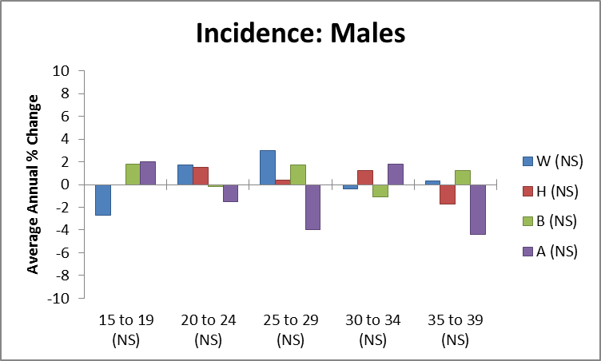
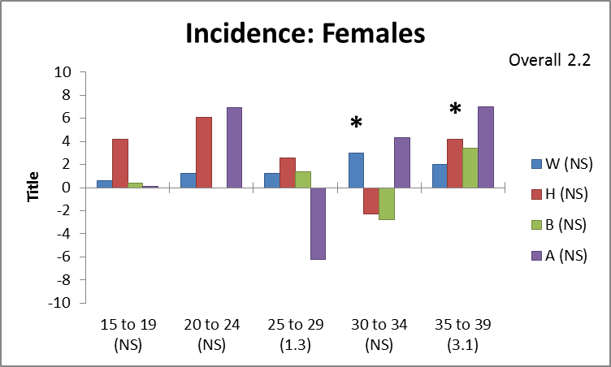
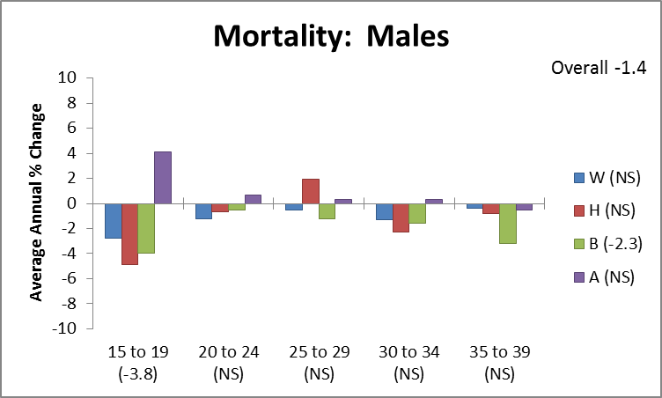
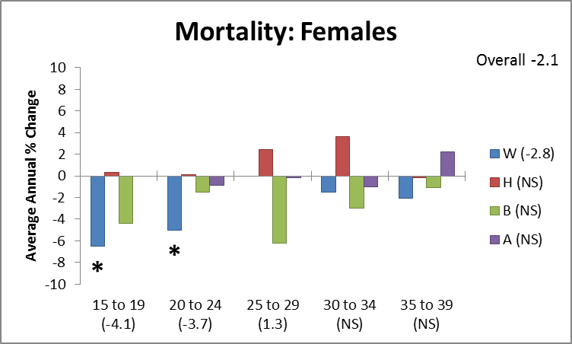
LEUKEMIA
TRENDS
Overall
Incidence
Males NS
Females +2.2
Mortality
Males -1.4
Females -2.1
Notes:
TRENDS ARE COMPLEX
INCIDENCE RATES APPEAR STABLE IN MALES, NO CLEAR PATTERNS BY AGE OR RACE/ETHNICITY (BARS WITH LARGER DECREASES ARE FOR ASIANS, SO UNSTABLE DUE TO SMALL SAMPLE SIZE)
INCIDENCE RATES INCREASING IN FEMALES, PARTICULARLY OLDER WHITES AND HISPANICS
MORTALITY RATES DECREASING FOR BOTH MALES AND FEMALES. PARTICULARLY LARGE DECREASES FOR YOUNGER WOMEN.

Slide 23
LEUKEMIA: Summary
Incidence rates
  Modest increase with age
  Female less than male
  Possible increase in females, particularly older
Mortality rates
  Modest increase with age
  Female less than male
  Decreasing, particularly younger females

Slide 24
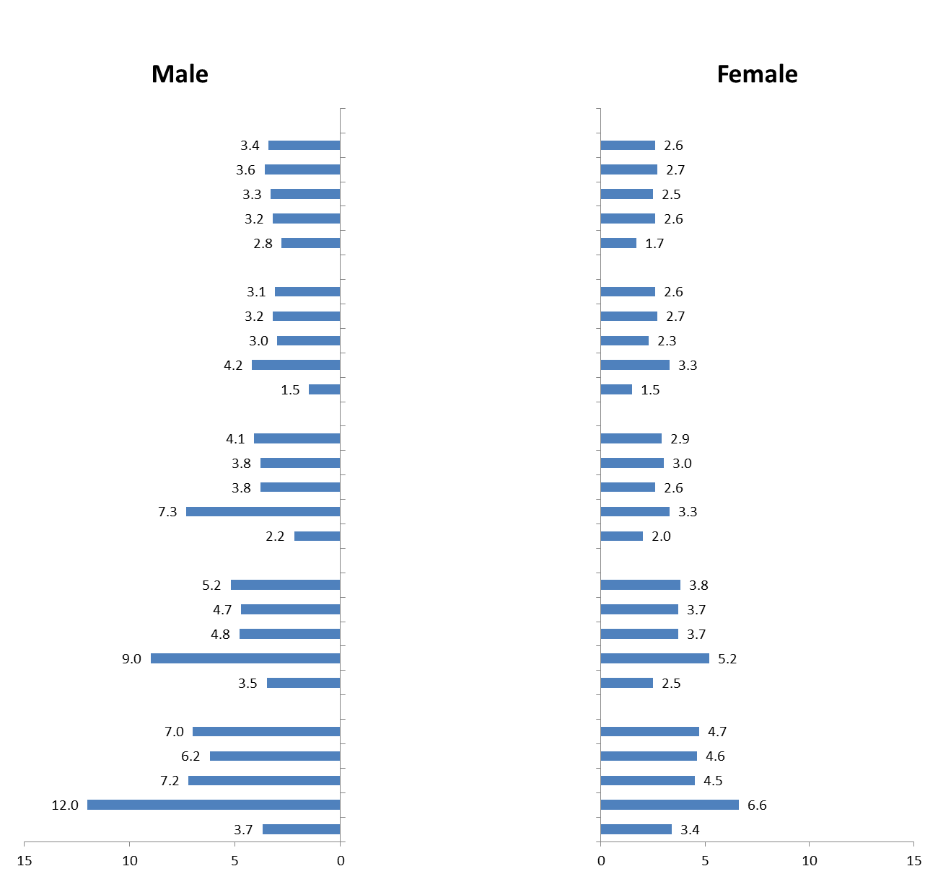
SARCOMA
INCIDENCE
per 100,000
2001-2010
Ages 15-19
All Races
White Non-Hispanic
White Hispanic
Black
Asian/Pacific Islander
Ages 20-24
All Races
White Non-Hispanic
White Hispanic
Black
Asian/Pacific Islander
Ages 25-29
All Races
White Non-Hispanic
White Hispanic
Black
Asian/Pacific Islander
Ages 30-34
All Races
White Non-Hispanic
White Hispanic
Black
Asian/Pacific Islander
Ages 35-39
All Races
White Non-Hispanic
White Hispanic
Black
Asian/Pacific Islander
Notes:
INCIDENCE RATES FOR SARCOMA RANGE FROM 1.5 TO 12.0 PER 100,000
MORE EVENLY DISTRIBUTED ACROSS AGE GROUPS, ALTHOUGH, AGAIN, MORE COMMON IN OLDER AGE GROUPS
INCIDENCE RATES NOTABLY HIGHER IN BLACK MALES AND, TO A LESSER EXTENT, BLACK FEMALES

Slide 25
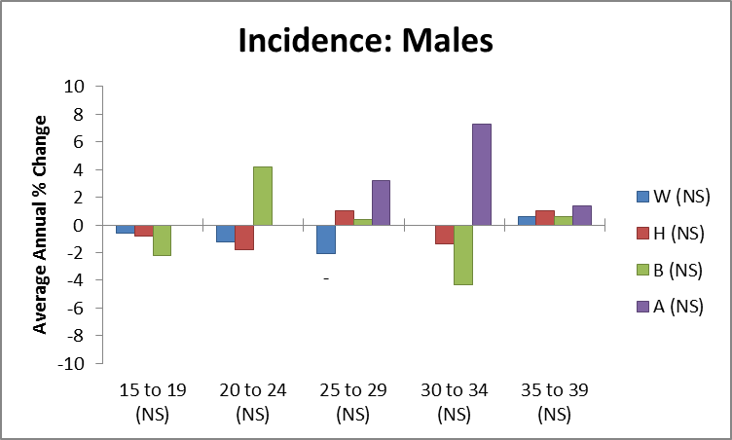
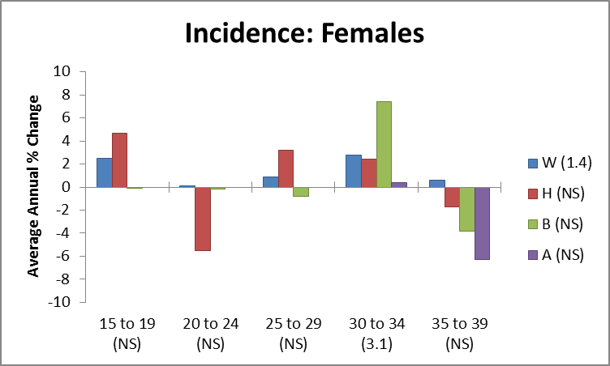
SARCOMA
TRENDS
Incidence NS
Notes:
SLIGHT HINT OF INCREASED INCIDENCE RATES IN OLDER WHITE WOMEN, BUT REALLY NO CLEAR PATTERN

Slide 26
SARCOMA
Incidence
  Occurs across age groups, although still increases with age
  More common in black males (& females)
  No trend

Slide 27
OVERALL INCIDENCE: SUMMARY
Thyroid and kidney carcinoma are dramatically increasing in AYAs and older adults (and for thyroid cancer, also in children).
Colorectal and testis carcinoma is increasing in young AYAs but not as rapidly as thyroid and kidney cancer.
ALL was increasing in and only in AYAs, but the trend slowed in 2008 (data not shown).
Breast cancer may be increasing in young AYAs during the past decade.
Melanoma declined in older AYAs as did lung cancer and carcinoma of the cervix in young AYAs.

Slide 28
Risk of cancer* from age 15 to 39 SEER18
2000-2002
2008-2010
1 in 59
1 in 56
*including “non-invasive”, “benign”, “borderline”

Slide 29
Risk of cancer* from age 15 to 39 SEER18
Females
2000-2002
2008-2010
1 in 48
1 in 44
*including “non-invasive”, “benign”, “borderline”

Slide 30
Risk of cancer* from age 15 to 39 SEER18
Non-Hispanic White Females
2000-2002
2008-2010
1 in 41
1 in 38
*including “non-invasive”, “benign”, “borderline”

Slide 31
Death Rates

Slide 32
One of 10 deaths in 15-39 year-olds is due to cancer (neoplasms)
2010
1 in 10
Same rate since 1988
Notes:
U.S.

Slide 33
One of 14 deaths in 15-39 year-old males is due to cancer (neoplasms)
2010
1 in 14
Same rate since 1987
Notes:
U.S.

Slide 34
One of 6 deaths in 15-39 year-old females is due to cancer (neoplasms)
2010
1 in 6
Same rate since 1993
Notes:
U.S.

Slide 35
One of 4 deaths due to disease in 15-39 year-olds is from a neoplasm
2010
1 in 4
Same rate since 1969

Slide 36
One of 5 deaths due to disease in 15-39 year-old males is from a neoplasm
2010
1 in 5
Notes:
U.S.

Slide 37
One of 4 deaths due to disease in
15-39 year-old females is from a neoplasm
2010
1 in 4

Slide 38
Incidence including Cancers with “Non-Malignant” Behavior

Slide 39
Proportion of All Cancer that is not Reported as Malignant,
by Individual Year at Diagnosis, SEER18, 2000-2009
18%
16%
14%
12%
AYAs:
12%-16%
“Non-Malignant”
“Non-Malignant”
10%
8%
6%
4%
AYA
2%
0%
0
5
10
15
20
25
30
35
40
45
50
55
60
65
70
75
80
85
Age at Diagnosis (Years)

Slide 40
Proportion of All Cancer that is not Reported as Malignant,
by Individual Year at Diagnosis and Sex, SEER18, 2000-2009
22%
AYA Females:
14%-22%
“Non-
Malignant”
20%
18%
Females
16%
14%
AYA Males:
8%-12%
“Non-
Malignant”
12%
10%
8%
Males
6%
4%
AYA
2%
0%
0
5
10
15
20
25
30
35
40
45
50
55
60
65
70
75
80
85
Age at Diagnosis (Years)
Notes:
Figure 2 shows the proportion of all cancer that is not reported as malignant as a function of patient age at diagnosis. AYAs have the largest proportion of these tumors, especially females. Two distinct peaks are apparent in females and to a lesser extent in males. The 2nd peak, beginning at the age of 40, is likely due to breast cancer detected via screening mammography that in the U.S. starts at this age. The first peak in females, which has a zenith at age 20 is distinctly in the AYA age range. In males, there appears to be a peak in the early and later AYA years, of 10- to 20- and 25- to 40-years, respectively.

Slide 41
Comparison of Survival of All Cancer and
of Malignant Cancer, 2000-2010, SEER18
100%
90%
80%
95% C.I.
95% C.I.
70%
60%
Non-Malignant Behavior (N=21,566)
50%
All Cancer (N=221,793)
40%
Malignant Behavior (N=200,227)
30%
The 95% confidence interval at 10-years for all cancer is 77.7%-78.2%.
20%
10%
0%
0
1
2
3
4
5
6
7
8
9
10
Years after Diagnosis

Slide 42
AYA Cancer Survival Trends

Slide 43
Annual Average % Change (AAPC) in 5-Year Relative Survival by Age
1990-2004
Best Prognosis
All Other Cancer
Hodgkin Lymphoma
Melanoma
Thyroid Cancer
Testicular Carcinoma
Except Kaposi Sarcoma and
Non-Hodgkin Lymphoma
1.8
1.6
1.69
1.4
1.45
1.2
1.29
AAPC
1.0
0.8
0.85
0.81
0.6
0.63
0.68
0.64
0.63
0.55
0.4
0.46
0.44
0.2
0.27
0.30
0.32
0.19
0.21
0.22
0.20
0.08
0.11
0.14
0
0.07
10
15
20
-0.1
25
30
35
40
45
50
55
60
65
70
Age at Diagnosis (Years)
Notes:
Figure 5 shows the most recent AAPC (1993-2004) in the 5-year relative survival rate of the best prognosis cancer types in AYAs (Hodgkin lymphoma, melanoma, and cancer of the thyroid and testis) in comparison to all other cancers except Kaposi sarcoma and non-Hodgkin lymphoma (to eliminate the effect of the HIV/AIDS era, as a function of age at diagnosis. AYAs has the least survival improvement for the both the best and worse prognosis groups. The greatest improvement in survival prolongation was above the age of 45, again for both poor and good prognosis groups of cancer.

Slide 44
Beyond Seer: Leveraging and Expanding AYA Data Resources
Improving data collection: defining key relevant variables and standardizing collection
Data harmonization/pooling in current and future studies
Expand capture of population-based AYA cancer epidemiology beyond SEER.
Access data captured by Electronic Health Records, Health Information Exchanges , Accountable Care Organizations and Health Insurance Firms.
Notes:
Current data capture and epidemiological assessments focus on incidence and mortality- we know little about the demographic, lifestyle, genomic, clinical and psychosocial factors –as well as interactions among these factors which influence outcomes. Our goal is to identify ways to optimize research strategies and leverage existing resources. Generally the recommendations fall into 3 categories: study coordination and implementation, data harmonization and pooling and 3) enhanced data resources
1) Determining the key variables depends on the research question—but certain baseline data should be included to evaluate outcomes. Critical factors in addition to treatment that are documented to influence outcomes include age, gender/race ethnicity, comorbidities and some lifestyle factors –Also collecting bio specimens for molecular and other biomarker measures is becoming more important in predicting outcomes. In doing so we can expand current and future research to address multiple dimensions of cancer and engage interdisciplinary teams in research
2) Pooling studies can maximize efficiency for increased statistical power—with advantages of capturing wide range of diverse populations—there are of course limitations including heterogeniety across studies in terms of exposure, outcome assessment, inclusion criteria. A first step would be to create an online repository of AYA study centers, investigators, definitions, protocols, and self-report instruments

Slide 45
Beyond Seer: Leveraging and Expanding AYA Data Resources
Pursue linkage of data from SEER with Medicaid, state cancer registry data and large insurers
Leverage existing and future studies involving AYA that are not cancer focused
Conduct an AYA-Focused NCI Patterns of Care Study
Notes:
Linkage of SEER data with registry data and data sets of large insurer is being used effectively in epidemiological research. In my home state of Texas the registry is using such a strategy for Comparative Effectiveness Research
There exist opportunities to leverage existing and future studies that are not cancer focused, but involve AYA populations, including large cohort cardiovascular, diabetes and obesity trials.
NCI’s Pattern of Care Study – In 2007, one POC study covered cancers that are among those experienced by AYAs including cervical, testicular, Ewings sarcoma, childhood ALL. An additional POC study focused on the AYA population would provide new information on treatment of AYAs in community practice and perhaps identify gaps in dissemination of treatment modalities and variations in therapy…with the potential of reducing disparities in treatment and survival among the AYA population.
Our goal was to identify ways to optimize research strategies and leverage existing resources. Generally the recommendations fall into 3 categories: study coordination and implementation, data harmonization and pooling and 3) enhanced data resources. Confronted with limited resources and funding it is important to address high priority scientific questions about AYA cancers and survivorship in the most cost effective way.

Slide 46
Questions for Discussion
Can the work of other groups provide a context in which to understand these data?
What do these data suggest about future prevention, clinical, and research priorities?
What are the next steps in terms of data to address future priorities?

Slide 47
Overall Summary
Incidence and mortality rates increase with age
  Complex patterns by sex and race/ethnicity
Rate trends
  Decreasing: breast cancer mortality, melanoma incidence, & leukemia mortality
  Increasing: colorectal incidence & leukemia incidence
Need additional data sources
  Leverage existing study and health plan data
  Repeat POC study

