Slide 1
AYAO WORKING GROUP 4: HEALTH SERVICES DELIVERY
Karen Albritton, Chair
Rebecca Block
Jacqueline Casillas
Peter Coccia
Rebecca Johnson
Erin Kent
Brandon Hayes-Lattin, Co-Chair
Larissa Nekhlyudov
Arnold Potosky
Stuart Siegel
Ashley Wilder Smith

Slide 2
Health Services Delivery
What is best outcome? (gold standard)
What elements of health care produce that outcome? (quality of care)
Who/Where is delivering those elements? (centers of excellence)
Why isn't everyone?(QOC delivery barriers)
Are patients getting to those providers/places that deliver QOC? (access)
What characteristics of patients determine if they get QOC? (disparities)

Slide 4
ACTUAL OUTCOME FOR A POPULATION
GOLD STANDARD CARE FOR A POPULATION
HYPOTHETICAL PERFECT OUTCOME (SURVIVAL)
QUALITY OF CARE: “The degree to which health services for individuals and populations increase the likelihood of desired health outcomes and are consistent with current professional knowledge.”

Slide 5
QUALITY OF CARE OUTCOME METRICS
TUMOR
Disease-free survival
Overall survival
Cancer as cause of death
Treatment related morbidity as cause of death
PATIENT
HRQOL
Physical
Psychological/social/spiritual/existential
Satisfaction with care
Financial impact
SOCIETAL
Cost
QALY
What is comparison group? What is bar?
Influenced by many social and clinical factors besides care
Rarity of comparable cases
Length of time to obtain
Need intermediate outcomes
Lack of validation of measures in AYAs

Slide 6
Patient satisfaction with care
Satisfaction ≠ quality of care
But is measure of whether needs felt to be met, whether they were part of decision making
Zebrack needs study (unmet need/met need/ no need)
No studies evaluating relationship of unmet need and process or system variables
British found that unmet patient needs were higher among AYAs receiving care in non-specialized units than those in specialized units with services like peer support, age-appropriate information, and age-appropriate recreational facilities (Marris, 2011)

Slide 7
QUALITY OF CARE OUTCOME METRICS
TUMOR
Disease-free survival
Overall survival
Cancer as cause of death
Treatment related morbidity as cause of death
PATIENT
HRQOL
Physical
Psychological/social/spiritual/existential
Satisfaction with care
Financial impact
SOCIETAL
Cost
QALY

Slide 8
Financial impact
HOPE study: 625 reported negative impact
MEPS: compared with peers, AYA survivors have:
nearly 2x mean annual health care expenditures
Increased likelihood to be unable to work due to illness, have missed work days and have higher numbers of lost productivity days
2x mean annual lost productivity

Slide 9
Societal outcomes
Cost
No studies have examined cost to deliver recommended cancer-directed therapies (eg pediatric vs adult based ALL therapy) or recommended supportive care
No reports on cost to develop an “AYA program”
QALY and cost-effectiveness
No studies calculating utility values or QALYs in AYAs

Slide 10
Future priorities in QOC Outcome Metrics
Find intermediate clinical outcomes
Completion of therapy
Identify/develop and validate HRQOL measures in AYAs
Systematic data collection to measure outcomes

Slide 11
Future priorities in QOC Outcome Metrics
Measure cost: Novel linkages of hospital and ambulatory care discharge data, multiple payer, bankruptcy claims, Cancer Research Network, MEPS supplements
Measure cost effectiveness: define utility value and QALY for AYAs

Slide 12
QOC PROCESS METRICS
A valid process measure has evidence-based predictive relationship to outcome

Slide 13
PROCESS METRICS
Available AYA measures are survey and consensus based not evidence-based
Patient survey identified the elements that AYA patients felt were most critical to their care (Zebrack, 2006).
LiveSTRONG Young Adult Alliance Standards of Care Task Force consensus-based critical elements of care (Zebrack 2010):
timely detection;
efficient processes for diagnosis, initiation of treatment, and promotion of adherence;
access to health care professionals with AYA specific knowledge;
research that will derive objective oncology care guidelines
National Comprehensive Cancer Network (NCCN) supportive care guidelines- “Category 2A,” physician consensus (Coccia, 2012)

Slide 14
Outside of US not much better
UK (Teenage Cancer Trust/ NICE): ‘A blueprint of care for teenagers and young adults with cancer’
Australia (CanTeen and Cancer Australia): ‘The National Service Delivery Framework for Adolescents and Young Adults with Cancer’
Canada (Canadian Task Force on Adolescents and Young Adults): ‘Framework of care’ (Fernandez, 2011)

Slide 15
Elements of quality AYA care
Delivery of cancer-directed therapies with evidence of superior outcome in AYAs*
Availability of and accrual to clinical trials*
Availability, discussion and use of Fertility preservation
Availability and use of Mental health services
Availability and use of Palliative care services
Availability and use of Survivorship services (with appropriate transition)
Availability and use of Genetic and familial risk- assessment and counseling
Psychosocial needs assessment and interventions
Socioeconomic issues (insurance, finances, work) assessment and intervention
Health Behavior assessment and intervention (including risk-taking behavior like non-adherence, substance abuse and unsafe sex)
Age-appropriate health communication, education, and information resources

Slide 16
Optimal therapy
ALL has solid data showing difference in outcome by treatment
For other diseases, less clarity, given confounders of disease stage/ biology and other delivery variables

Slide 17
Optimal therapy delivery
AYA HOPE study
75% received “appropriate” therapy as determined by expert clinical consensus
44% of ALL, 79% of sarcoma
Varied by cancer type and clinical trial participation, not age at diagnosis, stage, race-ethnicity, SES, type of treating institution, or (among those under age 25) the specialty of the physician

Slide 18
Clinical trial enrollment
Few AYAs enrolled
Inability to randomize and enrollment bias makes impossible to prove independent role in survival
May relate to receipt of optimal care
AYA HOPE study, patients enrolled in clinical trials were more likely to receive appropriate therapy relative to those not in trials (78% vs. 66%, adjusted OR = 3.4, 95% CI 1.3 - 8.7) (Potosky, in preparation).
May move the knowledge gap as much as delivery gap
Do we take clinical trial to patient or take patient to clinical trial?

Slide 19
QOC Process Metrics Priorities
Define optimal cancer-directed care for common AYA cancers
Determine rate of receipt of optimal care for AYA cancers
Study patient adherence
Validate impact on outcomes
Interventional studies
Standardize definition and validate relationship with outcome of elements of AYA-specific supportive care (NCCN guidelines)
Determine rate of receipt of optimal supportive care

Slide 20
QOC STRUCTURAL METRICS
Provider Expertise or Specialty
Sites of care

Slide 21
Clinical expertise
Hypothetical benefit on outcome, but no identified studies (other than “specialty” structural outcome analysis)
Need clarification of “expertise”
Volume
Tumor specific or age specific
Specific training ( peds onc/med onc vs AYA onc)

Slide 22
Clinical expertise training
Several training programs in development
Evaluation of training should include:
process evaluation (quality of educational material and activities)
outcome evaluation (provider theoretical knowledge, practical skill, attitude, and behavior)
impact evaluation (change in quality of medical care)

Slide 23
Sites of Care
2 studies of differences in survival based on site
15-19 year olds with pediatric-specific cancers treated at a non-COG institutions have lower 5-year actuarial survival rates (Howell, 2007).
15-19 year olds with adult-type tumors may have better survival rates at non-pediatric institutions (Bleyer, 2010).

Slide 24
AYA Program Review
23 Self-identified “AYA Programs” were found.
20 Programs reachable and invited to participate in a 2-part information gathering.
Part 1: Phone interview on NCCN AYA Care Guidelines (n=20)
Part 2: Survey on LiveStrong YAA Critical Elements (n=17)

Slide 25
8 Program Components emerged
Psychosocial
Approach to treatment
Financial and Concrete Resources
Fertility
Education and Communication
Palliative Care
Survivorship care
Research

Slide 26
Structure and focus differences
5 did not have an adult/pediatric partner
10 are serving the entire AYA age group
19 report having an AYA champion
14 report having program staff
Differing structural focus
Psychosocial care
Fertility preservation
Disease-based
Consult service

Slide 27
Most common activities within most common components
Fertility
General discussion of risks and options
Referral within 24 hours
Considering fertility as essential in managing AYAs
Education and communication
Age-appropriate information
Online resources
Patient-Provider communication
Psychosocial intervention
Social-recreational programming
Face-to-face peer support
Camps and retreats
Online peer support
Support for communication
AYA support groups

Slide 28
AYA specific research
Engaging in research (8)
Promoting research (14)
Collaboration with
Other or more established AYA programs
Other departments – adult, peds, adolescent medicine, specialty
Personnel
Interns working on AYA research
Interdisciplinary team
Faculty with protected time dedicated
Funding and support
Pursue federal and local funding for AYA research
Support research with philanthropic funds and fundraising events
Support to faculty for preparation of grants for AYA research
Open COG trials and other AYA specific or AYA relevant trials
Communication about AYA studies including meetings and emails
Education about need for AYA research to faculty, staff, foundation
Disseminating AYA research
Assessing clinical trial enrollment

Slide 29
3 Prominent Gaps
Comprehensive psychosocial assessment
Outcome evaluation of intervention and service delivery
Engagement in AYA-specific research

Slide 30
Priority Research in Structural Measures
Determine where AYAs seen currently
Validate that “structure” of AYA program = “process” of AYA care
Examine clinician volume/expertise and outcome relationship

Slide 31
Access Issues in AYA Oncology
Timely and accurate diagnosis
Timely and appropriate oncology care
Quality oncology care

Slide 32
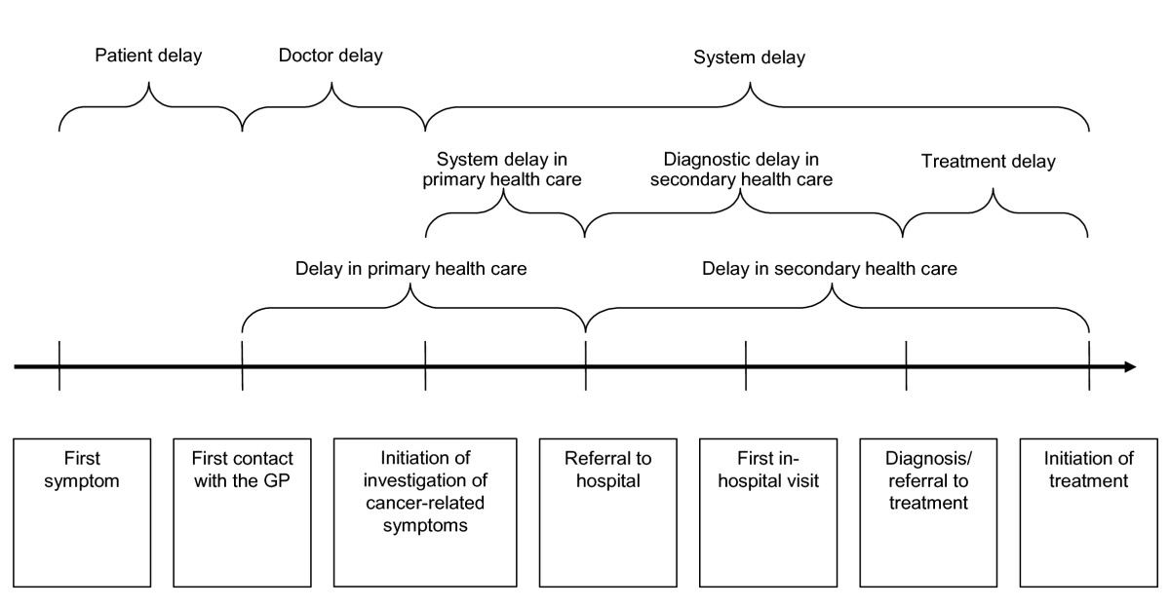
Delays in Diagnosis
Hansen et al. BMC FP 2011; 12: 100 http://www.biomedcentral.com/1471-2296/12/100

Slide 33
Timely and Accurate Diagnosis
Patient factors
lack of awareness of health care system
lack of awareness of worrisome symptoms
family and/or social dynamics/psychosocial
lack of insurance

Slide 34
Timely and Accurate Diagnosis
System factors
lack of insurance
poor access to care (unable to get an appointment)
lack of care continuity
Provider factors
lack of awareness of possible diagnosis
lack of experience diagnosing cancer in AYA
lack of time and resources

Slide 35
Timely and Accurate Diagnosis
Limited data for factors in delay in AYA
Delay from symptoms to presentation may be most important
“Meaningful” delay definition and effect on outcomes not clear
Limited data comparing AYA versus pediatrics
Suggesting delays in AYA
Limited data comparing AYA versus older adult
Variable findings, some differences by cancer type
Most research from Europe (UK, Denmark)

Slide 36
Timely and Appropriate Oncology Care
Why isn’t everyone getting to sites/providers that deliver best quality of care?
Similar factors as in timely diagnosis
BUT also in SYSTEM
Little data on where AYAs are getting care
Little data on how decisions for care made
Sites of care vary by cancer type
Variable effect of distance to site
Insurance

Slide 37
Access to Quality Care
Beyond structural issues determining timely diagnosis and referral, what factors determine if patients get QOC?
Access to/receipt of supportive care services
Social work, mental health
Fertility preservation
Palliative care
Patient cultural, developmental issues

Slide 38
Optimal therapy DELIVERY
Can prescribe same protocol, but delivery not the same
Ewing experience showed that AYA patients prescribed same therapy at pediatric/ more experienced hospitals did better than at adult/less experienced hospitals
Will learn from C10403 ALL study
Delays in therapy may be more likely in adult settings
ALL in France
EWS in Canada

Slide 39
Optimal therapy DELIVERY
Patient adherence critical
Studies in ALL oral medication show decrease adherence, but no study showing impact on survival
One interventional study targeting adherence in AYAs

Slide 40
Priority Questions in Access to Care
Access to Timely and accurate diagnosis
What is a delay?
Are there delays? Do they influence outcomes (stage at diagnosis, survival)
Factors in delays? (patient) provider, practice, insurance issues
How to intervene? Identify target symptoms?
Access to Timely and appropriate oncology care
Factors influencing referral to “AYA” designated care vs. adult/pediatrics?
Access to/delivery of Quality oncology care
Factors influencing delivery of elements
Adherence

Slide 41
Summary of Recommended Priority Gaps in Health Services Research
Outcome Measures:
Define intermediate outcomes
Validate HRQOL measures in AYAs
Measure cost
Measure cost effectiveness- define utility value and QALY
Measure and determine if delay in dx linked to stage at dx

Slide 42
Summary of Recommended Priority Gaps in Health Services Research
Process measures
Determine optimal cancer-directed care of common AYA cancers
Validate relationship between elements of quality care and outcomes (especially supportive care and HRQOL)
Investigate interventions to decrease delays: identify target symptoms recognition

Slide 43
Summary of Recommended Priority Gaps in Health Services Research
Structural measures
Determine where AYAs seen currently
Validate that “structure” of AYA program = “process” of AYA care
Examine clinician volume/expertise and outcome relationship
Determine (patient) provider, practice, insurance issues impacting delays

